Slide 1
Force and Motion

Slide 2
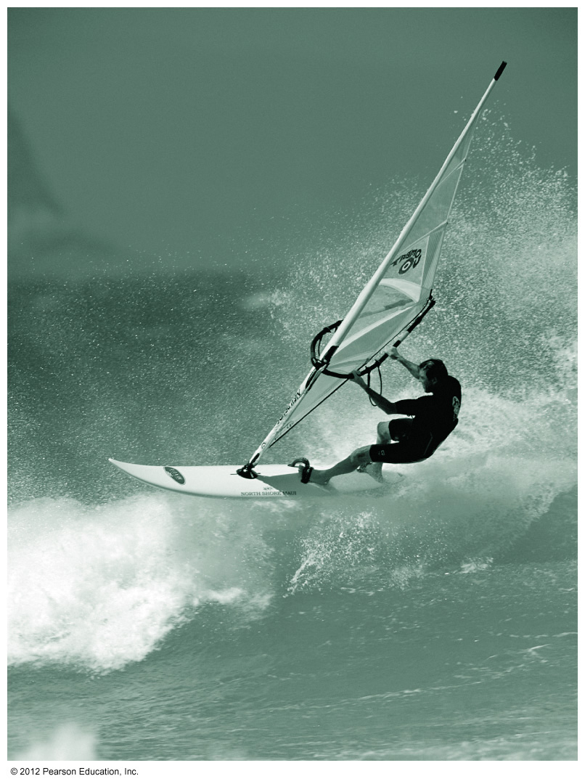
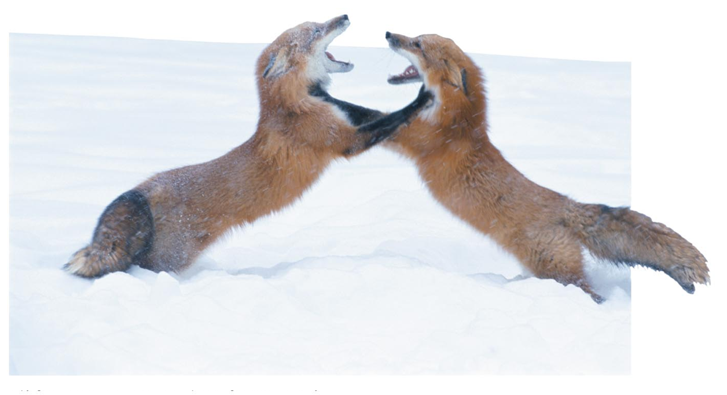
In this lecture you’ll learn
The concept of force and its role in causing changes in motion
The fundamental forces of physics
Newton’s three laws of motion
About the force of gravity
Including the distinction between mass and weight
How to apply Newton’s laws in one-dimensional motion
N
F
f
a
mg

Slide 3
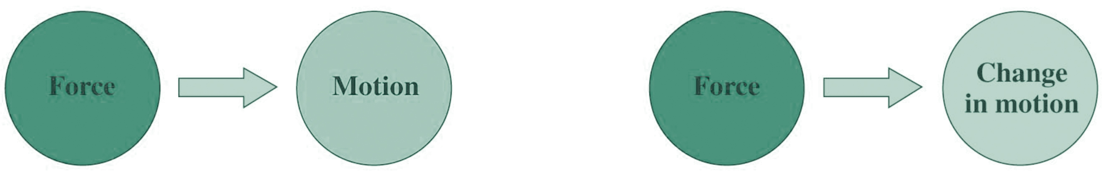
What Causes Motion?
That’s the wrong question!
The ancient Greek philosopher Aristotle believed that forces—pushes and pulls—caused motion.
The Aristotelian view prevailed for some 2000 years.
Galileo and Newton discovered the correct relation between force and motion.
Force causes not motion itself but change in motion.
The Aristotelian view
The Newtonian view

Slide 4
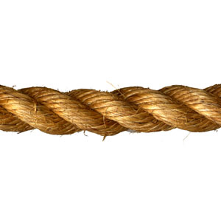
Force & Interactions
A quantitative measure of the mechanical interaction between two objects.
Types of forces:
Applied force; Normal force, Friction, Tension….
4 types of forces in nature:
Gravity; EM; Weak, and Strong forces (EM &Weak are together called Electroweak)
Force is a VECTOR
N
T
F
f
m
f
m

Slide 5
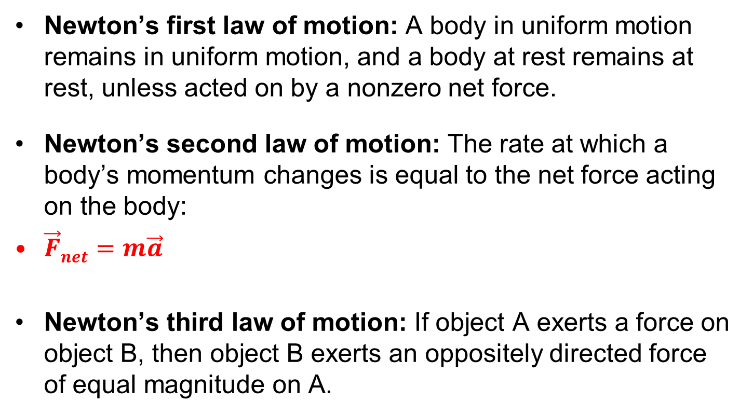
Newton’s Laws of Motion
(Newton’s 2nd Law)

Slide 6
The First Law
The first law is a special case of the second law, when there’s no net force acting on an object.
In that case the object’s motion doesn’t change.
If at rest it remains at rest.
If in motion, it remains in uniform motion.
Uniform motion is motion at constant speed in a straight line.
Thus the first law shows that uniform motion is a natural state, requiring no explanation.

Slide 7
Newton’s First Law (Inertia Law)
Every object continues either at rest or constant motion in a straight line if the total forces acting on it are equal to zero.
V = 0 (rest) or V = constant

Slide 8
Newton’s Second Law (The Law of Motion)
The acceleration is created by force
Units: Newton, N, 1 N = 1kg·m/s²

Slide 9
The Second Law (more general)
The second law tells quantitatively how force causes changes in an object’s “quantity of motion.”
Newton defined “quantity of motion,” now called momentum, as the product of an object’s mass and velocity:
Newton’s second law equates the rate of change of momentum to the net force on an object:
When mass is constant, Newton’s second law becomes
The force required to accelerate a 1-kg mass at the rate of 1 m/s² is defined to be 1 newton (N).

Slide 10
Mass & Weight
Mass, m: substance, conserved.
Weight, w: subjective, depending on gravity
Weight on the earth surface (gravitational force)

Slide 11
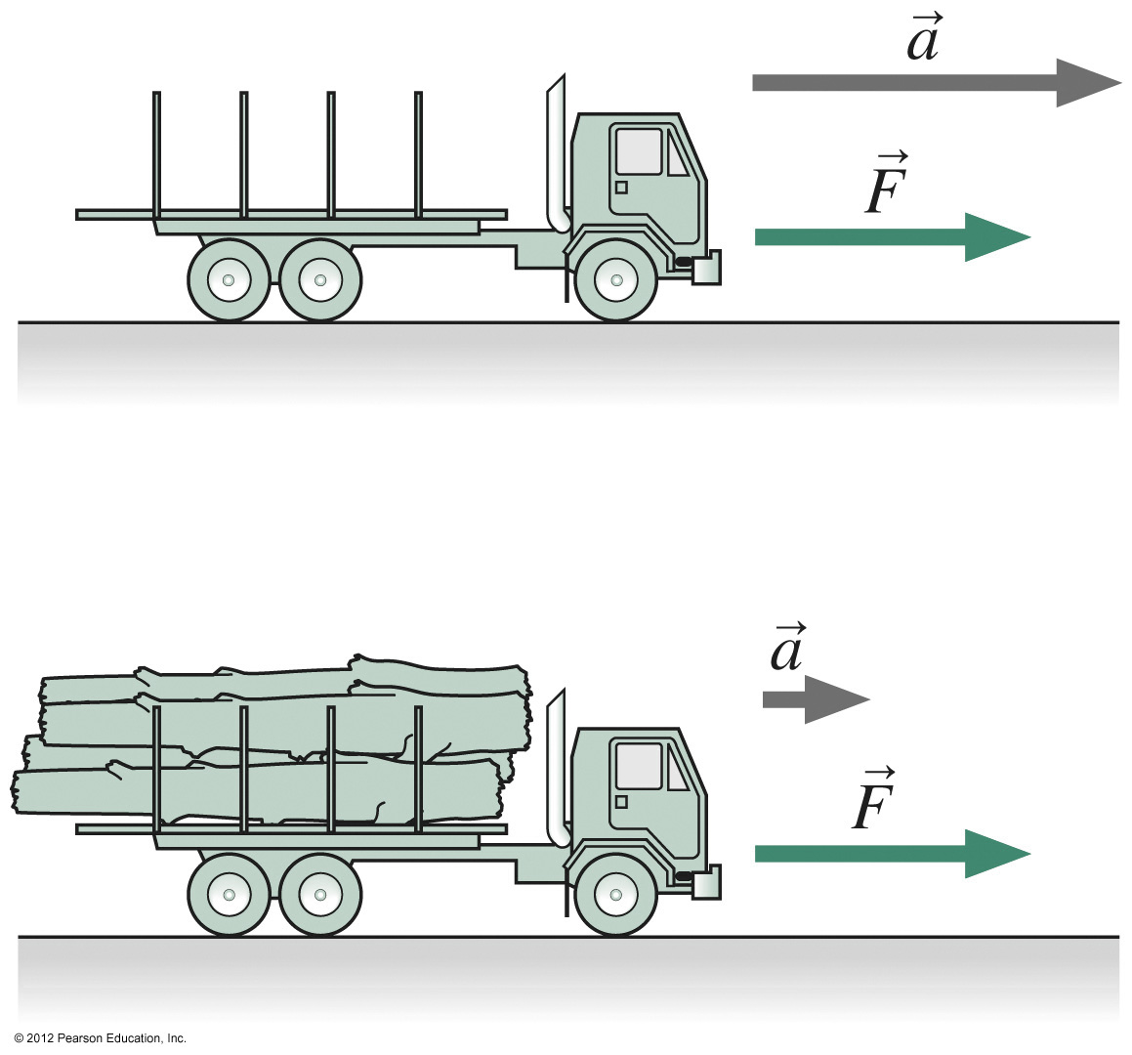
Mass, Inertia and Force
If we solve the second law for the acceleration we find that
showing that a given force is less effective in changing the motion of a more massive object.
The mass m that appears in Newton’s laws is thus a measure of an object’s inertia and determines the object’s response to a given force.
From Newton’s second law for a force of magnitude F,
we get

Slide 12
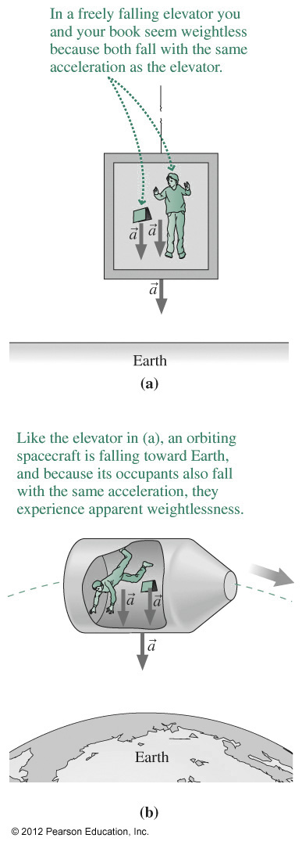
Mass, Weight, and Gravity
Weight is the force of gravity on an object:
Mass doesn’t depend on the presence or strength of gravity.
Weight depends on gravity, so varies with location:
Weight is different on different planets.
Near Earth’s surface, has magnitude 9.8 m/s² or 9.8 N/kg, and is directed downward.
All objects experience the same gravitational acceleration, regardless of mass.
Therefore objects in free fall—under the influence of gravity alone—appear “weightless” because they share a common accelerated motion.
This effect is noticeable in orbiting spacecraft
because the absence of air resistance means gravity is the only force acting.
because the apparent weightlessness continues indefinitely, as the orbit never intersects Earth.

Slide 13
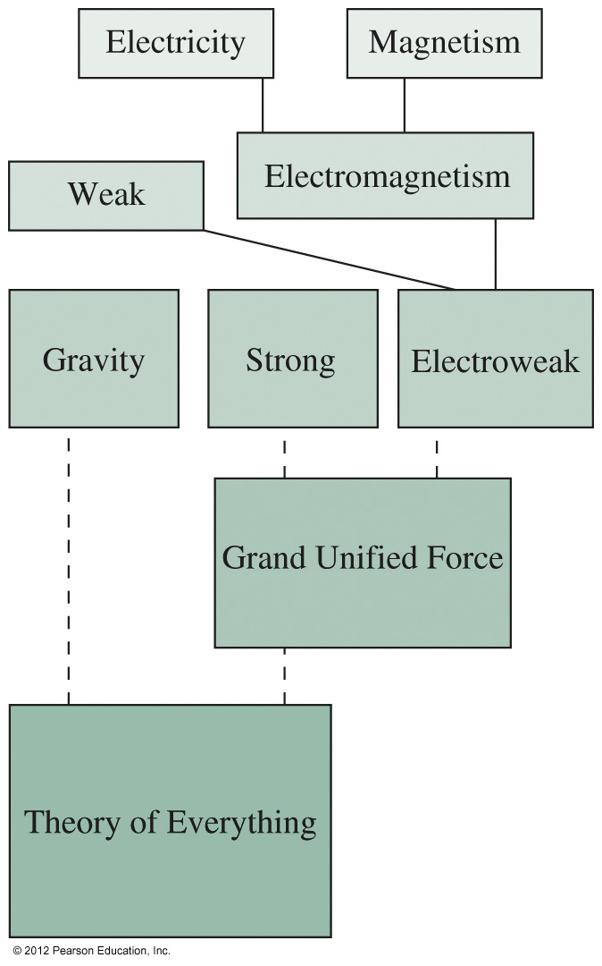
The Fundamental Forces
Physicists now recognize three fundamental forces:
Gravity
The strong force
The electroweak force
All common forces fall under these three categories.
Nearly all everyday forces, except gravity, are electromagnetic forces — one aspect of the electroweak force.
Historically, more forces were once regarded as fundamental, but were later understood to be related.
A goal of physics is to unify all forces in a “Theory of Everything.”

Slide 14
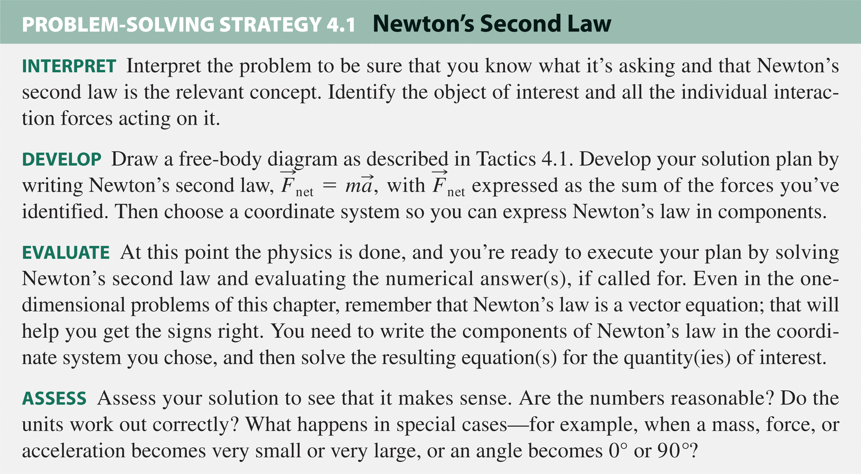
Solving Problems with Newton’s Second Law

Slide 15
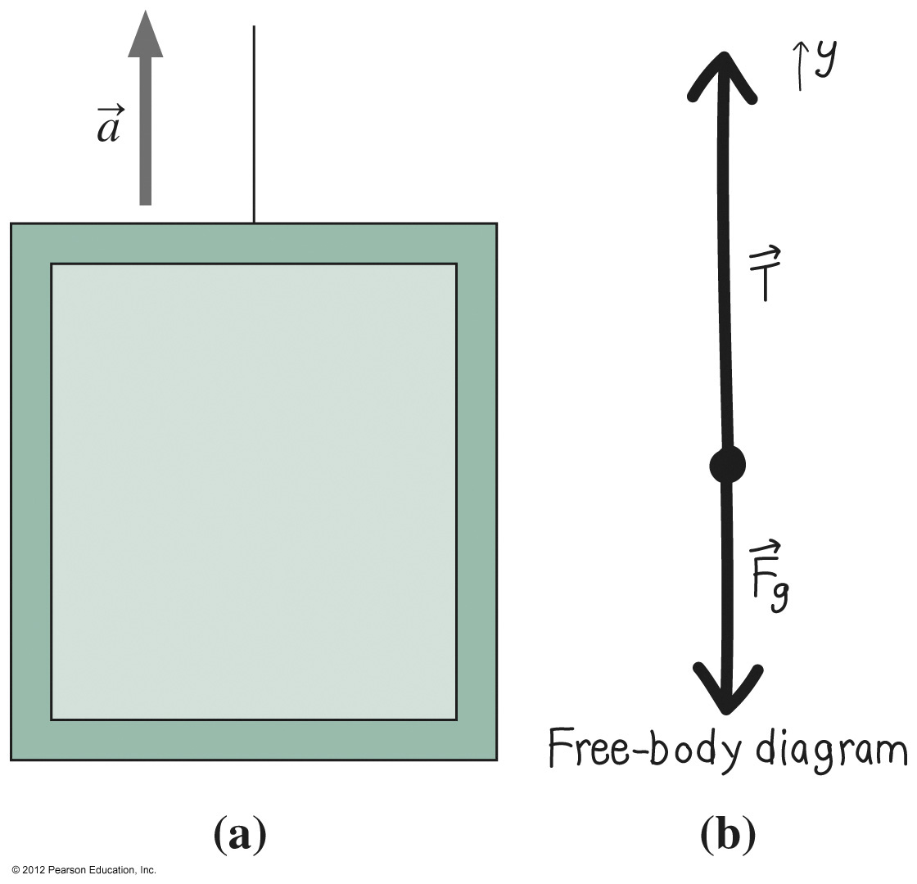
Example
A 740-kg elevator accelerates upward at 1.1 m/s², pulled by a cable of negligible mass. Find the tension force in the cable.
INTERPRET The object of interest is the elevator; the forces are gravity and the cable tension.
DEVELOP Newton’s law reads
EVALUATE In a coordinate system with y-axis upward, Newton’s law reads
Solving gives
ASSESS Makes sense; look at some special cases.
When a = 0, T = mg and the cable tension balances gravity.
When T = 0, a = –g, and the elevator falls freely.

Slide 16
Newton’s Third Law (Action & Reaction)
To every action there is always opposed an equal reaction, or, the mutual actions of two objects upon each other are always equal, and directed to contrary parts—Isaac Newton
Action force and reaction force are
Equal in magnitude
Opposite in direction
Acting on different objects
F_{on A by B} = -F_{on B by A}
A
B

Slide 17
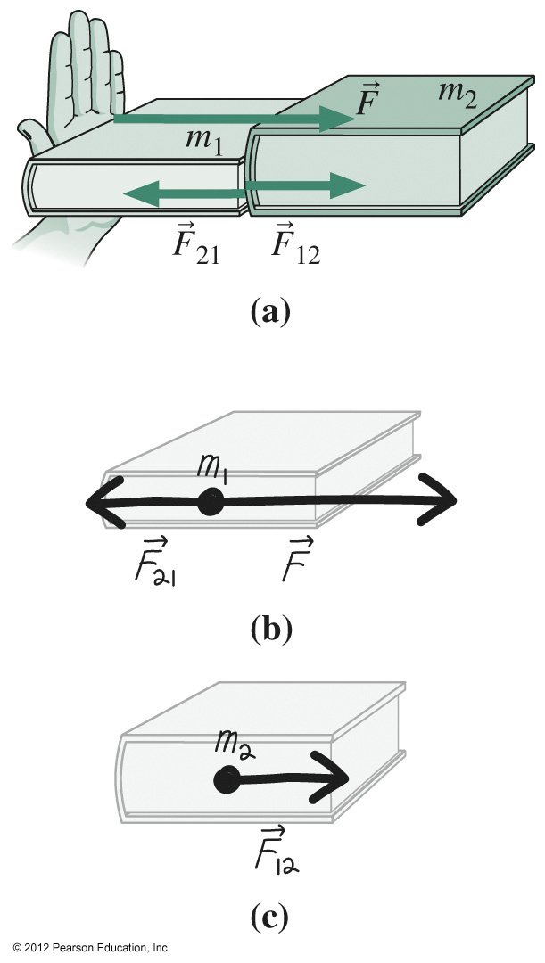
Newton’s Third Law
Forces come in pairs.
If object A exerts a force on object B, then object B exerts an oppositely directed force of equal magnitude on A.
Obsolete language: “For every action there is an equal but opposite reaction.”
Important point: The two forces always act on different objects; therefore they can’t cancel each other.
Example:
Push on book of mass m₁ with force
Note third-law pair
Third law is necessary for a consistent description of motion in Newtonian physics.

Slide 18
Free Body Diagrams
m
m
m
M

Slide 19
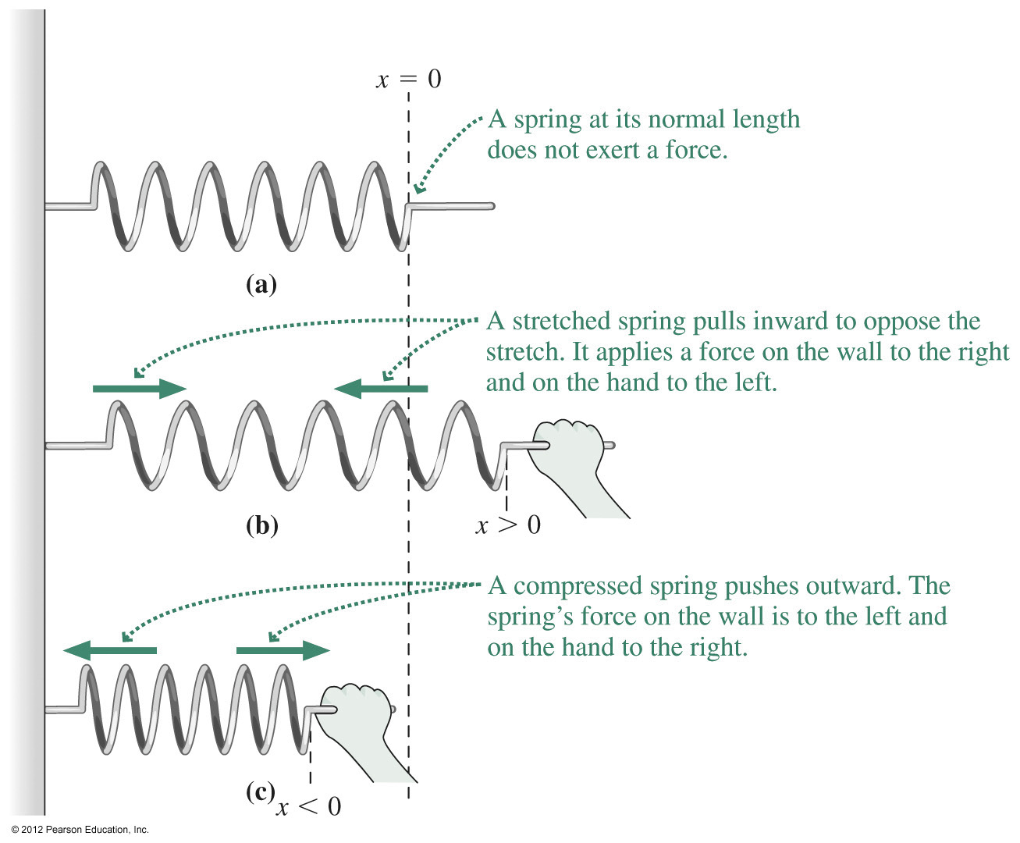
Spring Forces
A stretched or compressed spring produces a force proportional to the stretch or compression from its equilibrium configuration: F_{sp} = –kx.
The spring force is a restoring force because its direction is opposite that of the stretch or compression.
Springs provide convenient devices for measuring force.

Slide 20
Summary
In Newtonian physics, force—a push or pull—causes not motion itself but change in motion.
Newton’s three laws are
First law: A body in motion remains in uniform motion, and a body at rest remains at rest, unless acted on by a nonzero net force.
Second law: The rate at which a body’s momentum changes is equal to the net force acting on the body:
Third law: If object A exerts a force on object B, then object B exerts an oppositely directed force of equal magnitude on A.
Physicists recognize three fundamental forces.
An object’s weight is the force that gravity exerts on it.

Slide 21
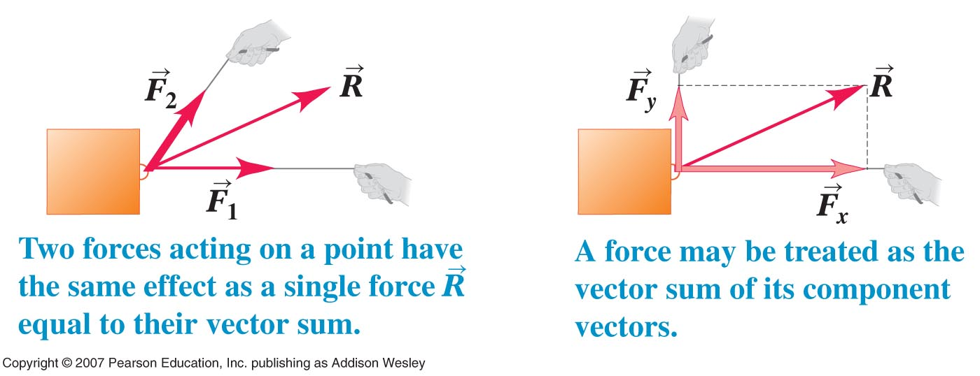
Summary

Slide 22
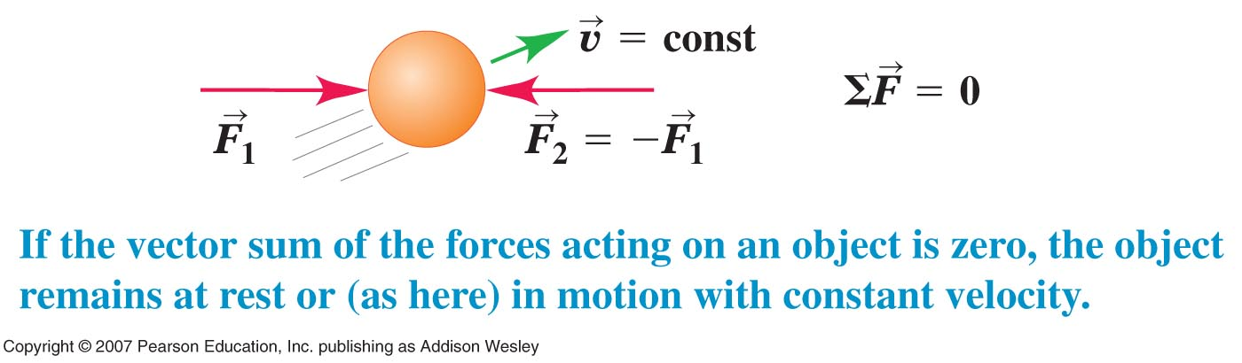
First Law

Slide 23
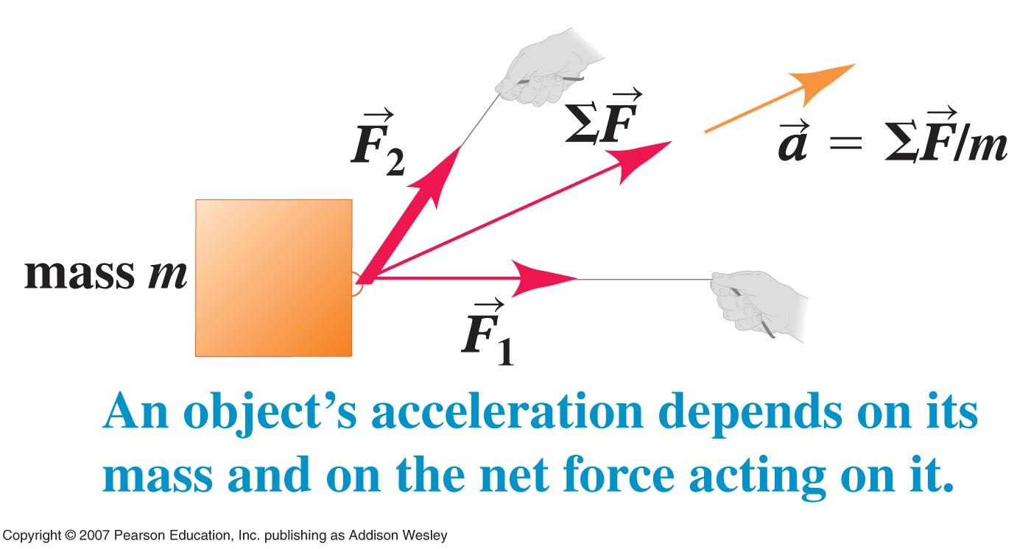
Second Law

Slide 24
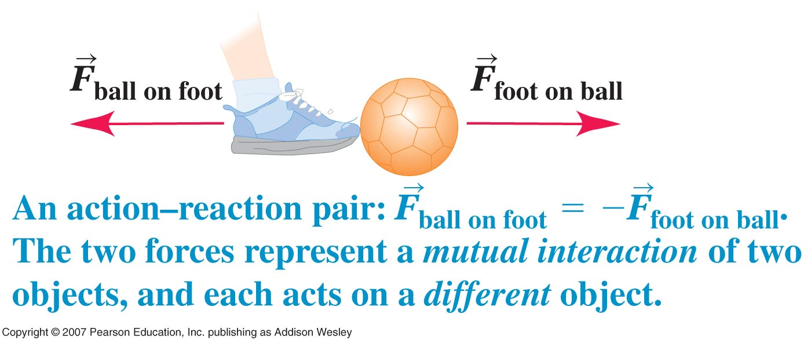
Third Law

Slide 25
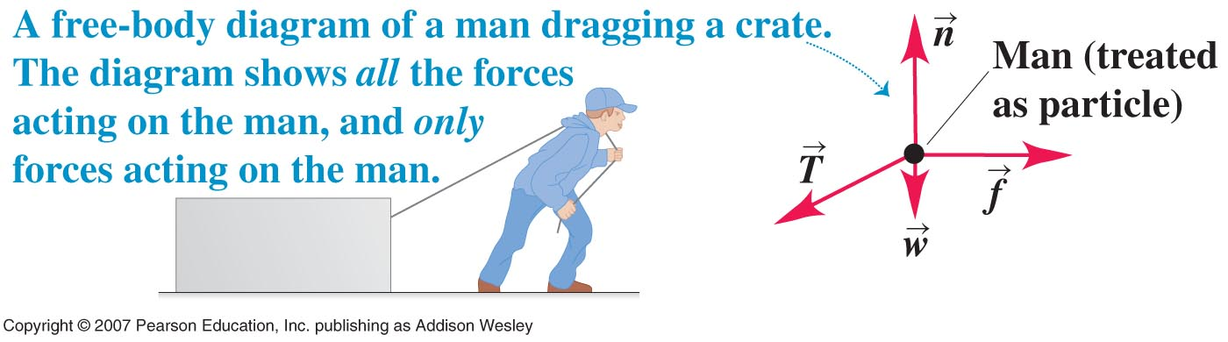
Free Body Diagrams
Or Crate (depends on which object studied
In Newton’s second law, only the forces acting on an object go into the F

